Slide 1
Opposition Analysis: Philadelphia Union

Slide 2
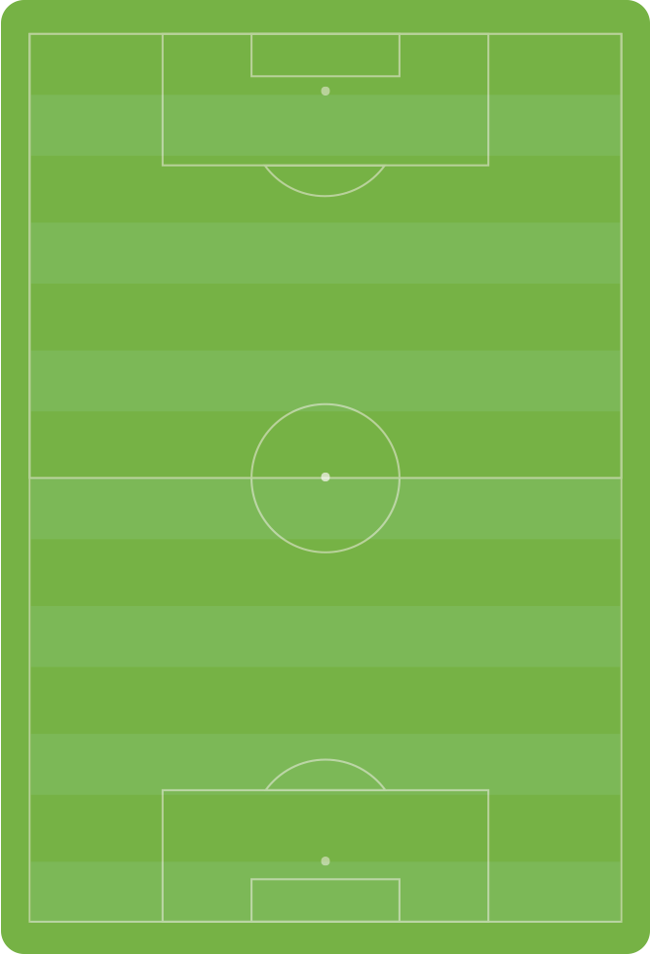



Lineup and Formation vs. Chicago Fire
Score: Union 4 - 3 Fire
Goals:
Campbell OG 11’
Alberg 15’, 45+1’, 56’ (pen)
Discipline:
Caroll 36’ (tactical foul)
Tribbett 37’ (tactical foul)
Subs
Joshua Yaro replaced Tribbett 45’
Le Toux replaced Ilsinho 72’
Creavalle replaced Alberg 77’ (Creavalle to CDM → 10 pushed a little higher
Formation Changes
None but 6 started dropping deeper with lead
33
13
Fabinho
Pontius
16
7
Marquez
Caroll
6
11
1
4
Alberg
Herbers
Blake
10
Tribbett
Barnetta
25
12
Rosenberry
Ilsinho

Slide 3
Lineup and Formation vs. Vancouver Whitecaps
Score: Union 2 - 3 Whitecaps
Goals:
Alberg 14’
Pontius 90+4’
Discipline
Barnetta 36’ (bad foul)
Substitutions:
Pontius replaced Ilsinho 65’
Restrepo replaced Herbers 75’
Fernandes replaced Fabinho 81’
Formation Changes
6 started staying really high, incorporated long throws while losing, outside backs pushed higher
33
9
Fabinho
Le Toux
16
7
Marquez
Caroll
6
11
1
Alberg
Herbers
Blake
15
J. Yaro
10
Barnetta
25
12
Rosenberry
Ilsinho

Slide 4
In Possession
6 pushes high almost like shadow striker
25 will tuck in, especially if ball is on opposite side
10 covers the entire pitch, 7 stays deeper
Outside backs don’t push forward too often, 12 will push forward when 25 tucks inside
33
13
Fabinho
Pontius
16
Marquez
6
7
1
Alberg
4
Caroll
Blake
10
11
Tribbett
Barnetta
Herbers
12
25
Rosenberry
Ilsinho

Slide 5
Chance Creation – Right Side Build Up
7
25 comes inside to pick up the ball
Opens space for 12 to push high
6 and 11 stay high to open highlighted space for 10
10 combines with nearby players, or switches to 13
Other chances come from long balls from defense, or turning the opposition over high up the pitch
Caroll
25
Ilsinho
10
13
Barnetta
Pontius
12
6
Rosenberry
11
Alberg
Herbers

Slide 6
Strengths and Weaknesses in Possession
Strengths
Weaknesses
Fluid in attack → players fill space, can be confusing for defenders, good rotations on right hand side
#6 Alberg is creative in his movement, finding good space for low, cut back crosses when #12 or #33 get endline
Building from back → 7 drops deep, 6 doesn’t help in build up but stays high, center of the pitch is open
Defenders opt for easy passes to nearby players that often put themselves under pressure

Slide 7
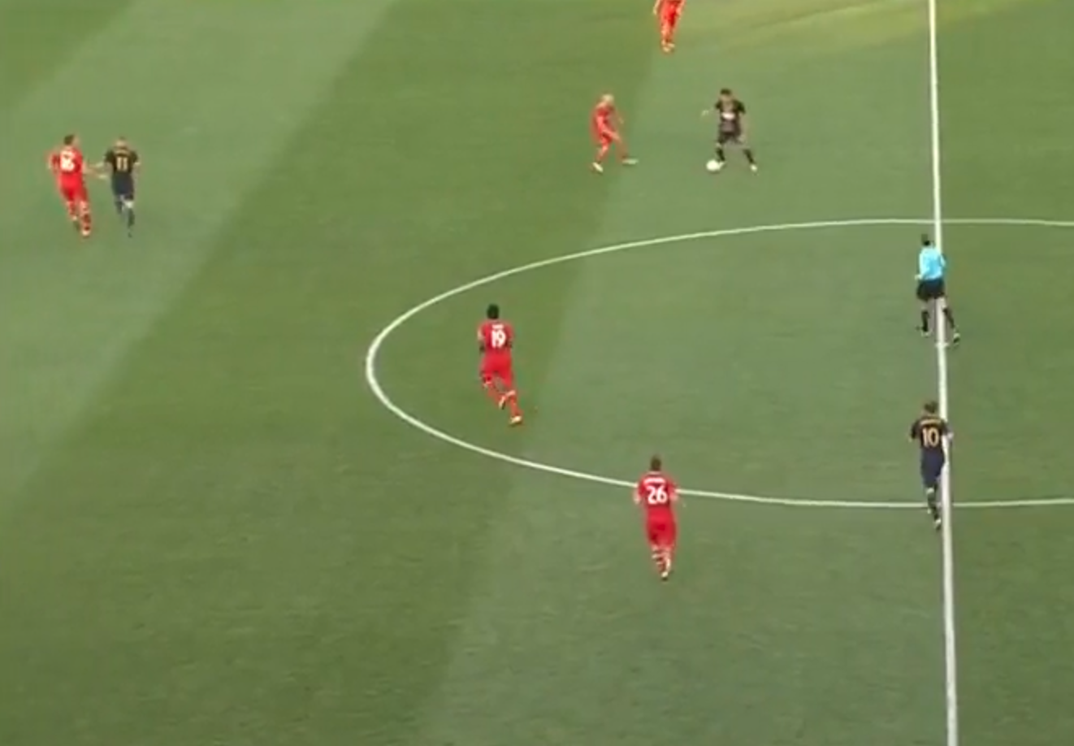
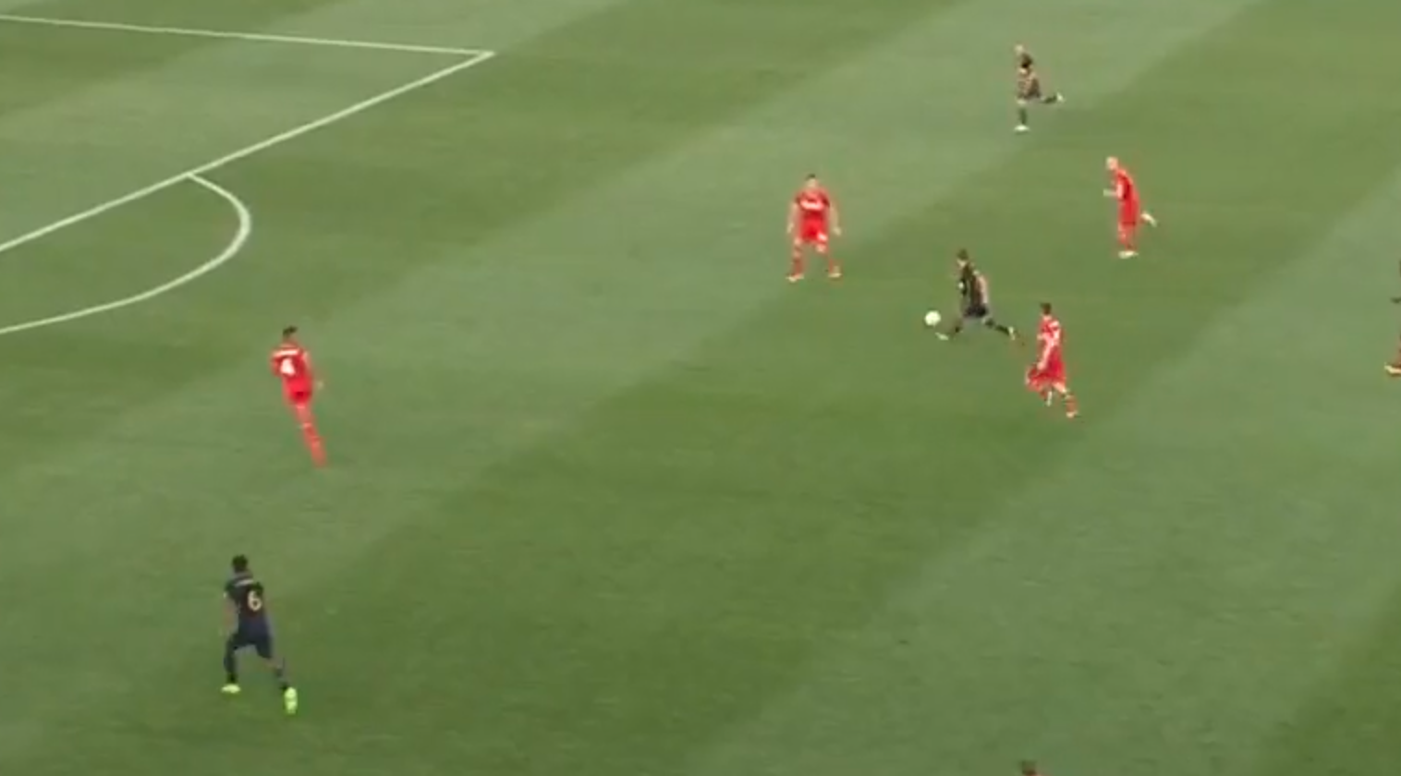
Strength 1
Left: 25 has dropped deep, bringing his defender. 11 recognizes and runs to fill space, taking his defender and opening up middle of the field for 10 to exploit.
Right: 10 receives pass and drives into space vacated by 11. 6 drifts wide to create a balanced 3v2. 11 ultimately has a shot saved and 6 scores of the rebound

Slide 8
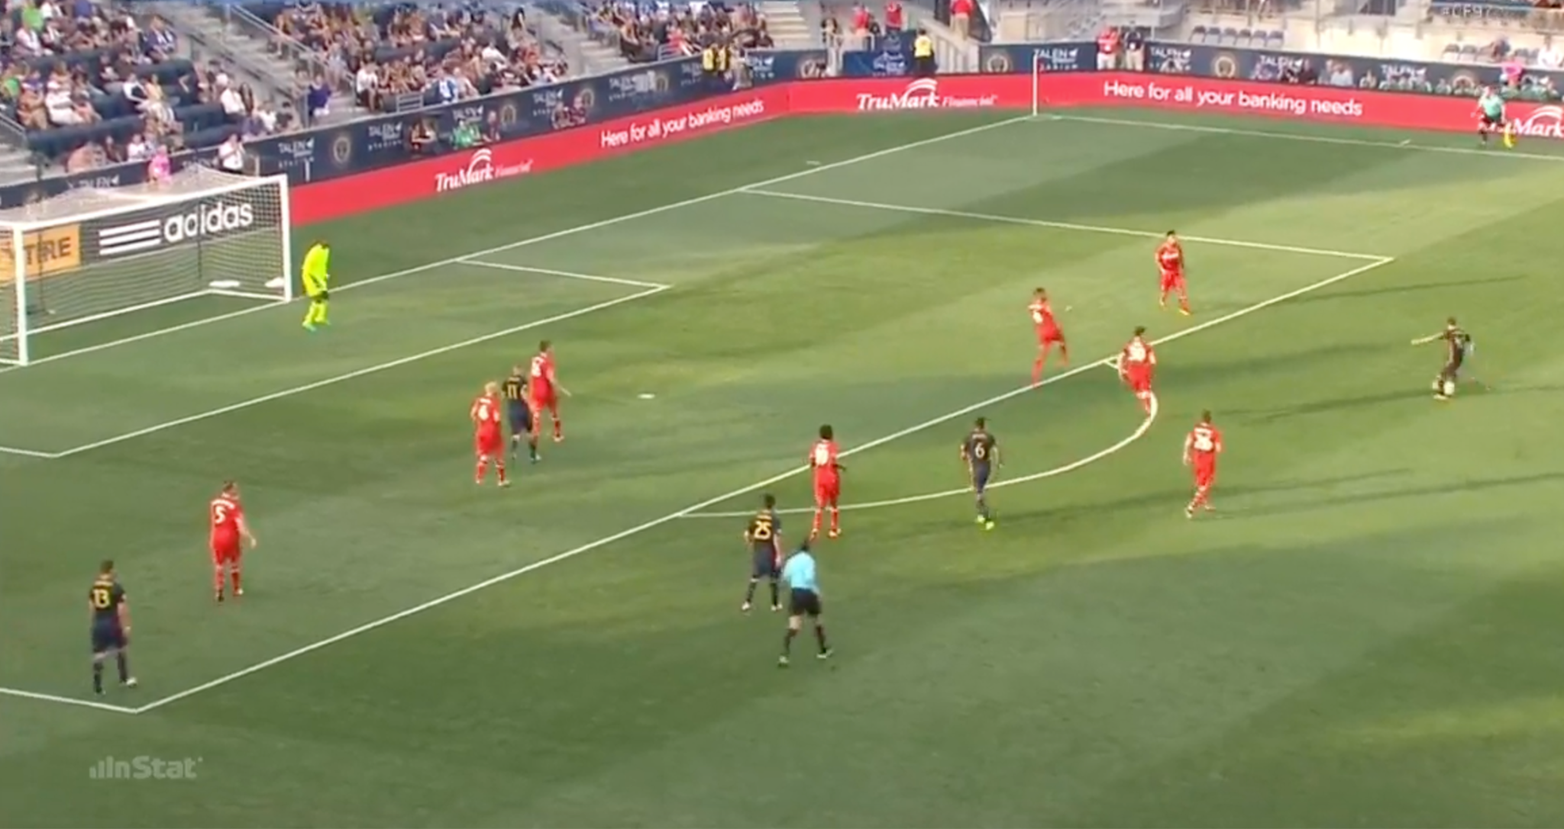
Strength 2
Rather than crowd the box get the ball, 6 looks for space in the box between the lines. As 10 shoots, he picks up an area in the middle with no defenders to look for a rebound, which he gets for a goal. He picks up these positions when outside backs or wingers look for low, cutback cross

Slide 9
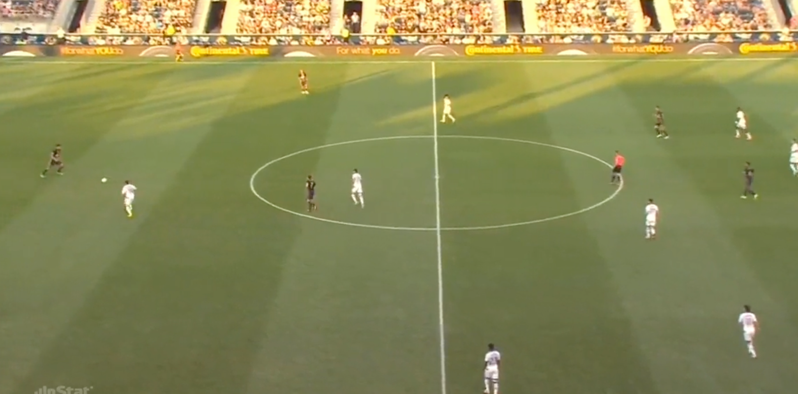
Weaknesses 1 & 2
Whitecaps defense is shifting to far side of field. Center back has option to play through press, albeit difficult. Opts to pass to left back instead and puts him under pressure as whole Whitecaps team is expecting

Slide 10
Out of Possession
Fullbacks tuck in and play narrow
Wingers drop and defend width
6 and 11 make little effort to defend or even provide resistance
13
33
Pontius
Fabinho
16
10
Marquez
Barnetta
1
6
11
Blake
4
7
Alberg
Herbers
Tribbett
Caroll
12
Rosenberry
25
Ilsinho

Slide 11
Strengths and Weaknesses out of Possession
Strengths
Weaknesses
Compact defense → when set up, difficult to play between defenders when opposition sustains possession
Overload ball-side → very vulnerable to switch of play
Midfield gets left open → 6 stays high, 10 drifts wide, slow to rotate when ball moves side to side
Vulnerable in transition

Slide 12
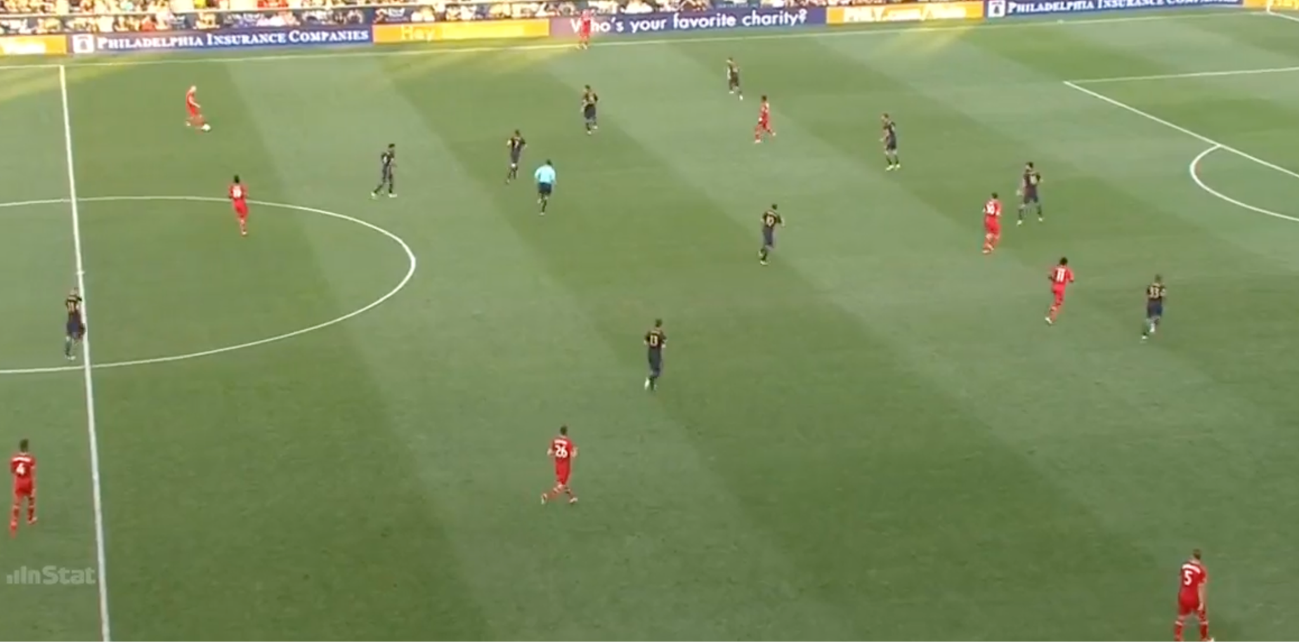
Strength 1
Compact defensively with numbers behind the ball, including wingers when opposition sustains possession. 10 and 7 are denying pass into midfield. 6 could be a little higher to deny switch, but can still apply pressure

Slide 13
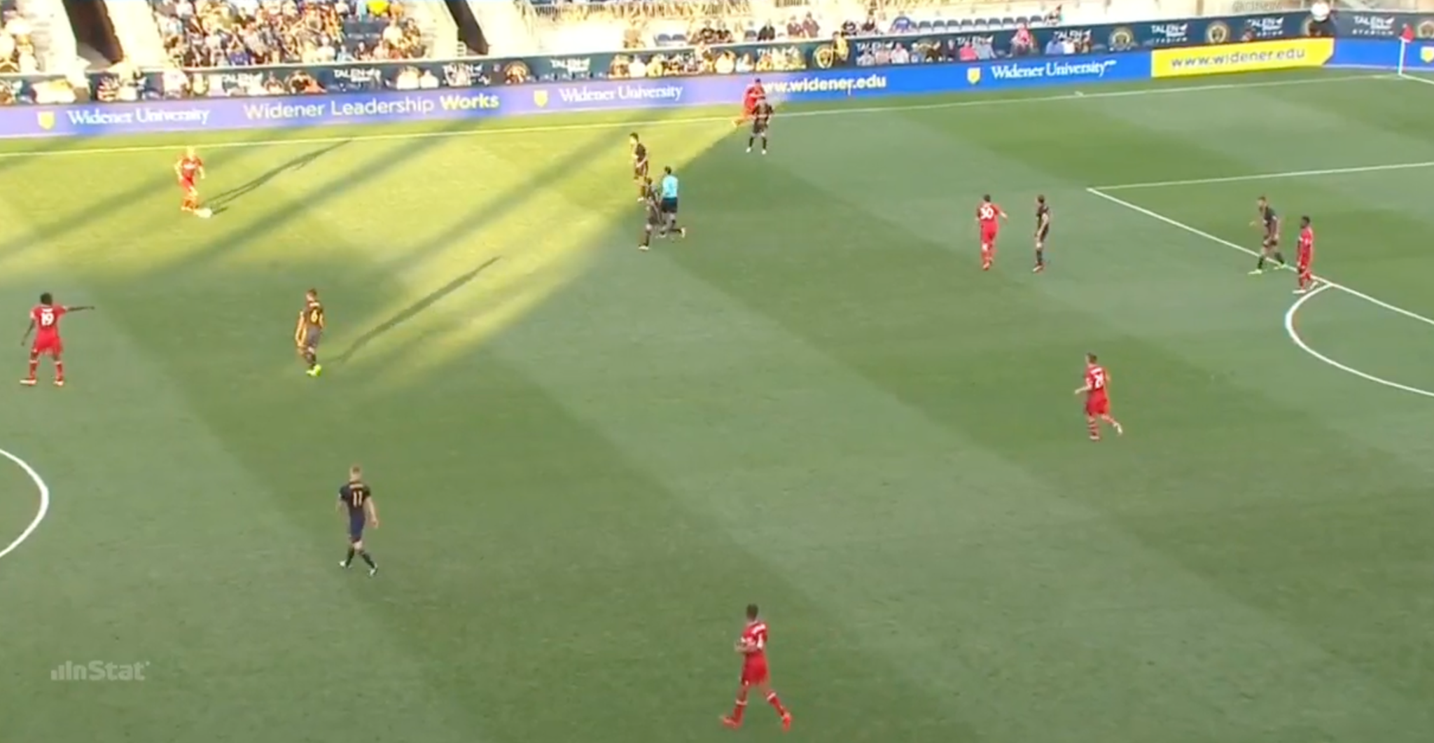
Weaknesses 1 & 2
Defensive shape breakdown. Same scenario as strength. Midfielders (highlighted in red) are pulled apart. 6 not dropping to help, 10 has gone to pressure where the winger should, 7 tracked a man towards the right. Leaves tons of space for someone to check into, in this case opposition CM

Slide 14
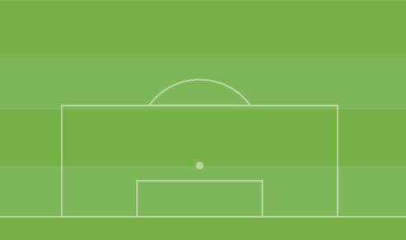

Attacking Set-Pieces: Free Kicks
6
10
Weird setup with 6 players on the edges of the box
Will also run more normal setup with 4-6 runners, 2 men on top of the box for rebounds

Slide 15
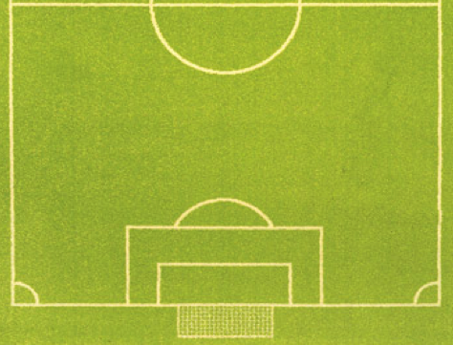
Attacking Set Pieces - Corners
Long
Short
6
10
10
* Short corners often go backwards, attack to try and turn them over → counter

Slide 16
Defensive Set Pieces: Free-Kicks
Numbers behind the ball: 10 or all 1, even if other team has only a few in box
Build wall, no one laying behind
Covered far post with wall when ball was in middle → exploitable wall construction

Slide 17
Defensive Set-Pieces: Corners
Hybrid Man - Zone system
Zone on top of box, man mark from top of 6 to 18
Will match however many men opposition put in box
Free men on top of 6 ball side, back post
No man on near post
Do not organize quickly → conceded against Fire because they were not set up for quick corner
Conceded another corner after missed header from front man

Slide 18
Individuals: Defenders
Fabinho: Left back #33
Generally stays back, behind winger in support
Best Union defender with ball at feet, combination play
Keegan Rosenberry: Right Back # 12
Solid defensively, plays close to center back
Not great passer, most passes to player next to him
Receives a lot of passes on sideline → put under pressure
Likes to overlap, play low crosses
Joshua Yaro: Center back #15
Old fashioned: tall, strong, not agile, not good with ball
Put under pressure, attack off dribble
Good pace
Ken Tribbett: Center back #4
Good cover for outside back
Will overcommit to challenges
Not a strong passer
Richie Marquez: Center back #16
Strong defensively, but will overcommit when covering
Not great with ball

Slide 19
Individuals: Midfield
Roland Alberg: Attacking Midfielder #6
Low effort, lower touch player → plays quick passes and drifts around field
Looks to fill gaps of space left by teammates, often away from the ball side
Late runs into the box for low crosses → target of a lot of wide crosses
Ball finds him because he picks up good spaces
Brian Carroll: Defensive Midfielder #7
Plays just in front of center backs
Comfortable on the turn, facilitating play from deep
Good defensive effort, but often goes too wide, leaving space in the middle of the field
Generally stay behind #10 and #6 when Union are attacking
Tranquillo Barnetta: Central Midfielder #10
High effort player → travels all across pitch making up for lack of effort from #6
Can be pulled out of position defensively by switches of play
Often on the right offensively → combines well with #25

Slide 20
Individuals: Attackers
Chris Pontius: Left Winger #13
Low touch player
Tends to stay wider
Looks to play crosses into box rather than really attack defense
Drops back defensively
Sam Le Toux Left Winger #9
Larger winger
Comes inside for crosses
Not going to attack outside back off the dribble, but will run in behind
Will press defensively, but mostly will drop back
Fabian Herbers: Striker #11
Good channel runner → Diagonal runs for long balls, often behind #25
Strong in the air and back to goal as outlet, not great with feet
Doesn’t press much, stay forward
Ilsinho: Right Winger #25
Tidy, touch heavy player
Looks to come inside and drop deeper to start possessions → leaves space behind for #12 or #11 to run into.
Drops back defensively out wide
Goes very central when ball is on opposite wing

Slide 21
Ways to Beat Philadelphia Union (Recap)
In Possession:
Switch play: Union midfield get stretched easily
Attack middle of field
Quick Set-pieces
Sustain Possession → passes pull them out of position
Out of Possession:
Pressure defenders → not great with ball
Win 2nd ball after Union go long
Communication, especially between LW, LB, and CMs when 25 comes inside and 12 overlaps
Numbers behind ball → Union not good in possession
Other Notes:
Transition is key* → Union play quick and are not great with sustained possession, also commit numbers forward → vulnerable in transition
Double Pivot in 4-2-3-1 setup would cause issues for 6 and 25 to find space

